Slide 1
Mathematics of Networks Review on Probability Theory
MA 653: Network Science
Instructor: Ashok Singh Sairam
ashok@iitg.ac.in

Slide 2
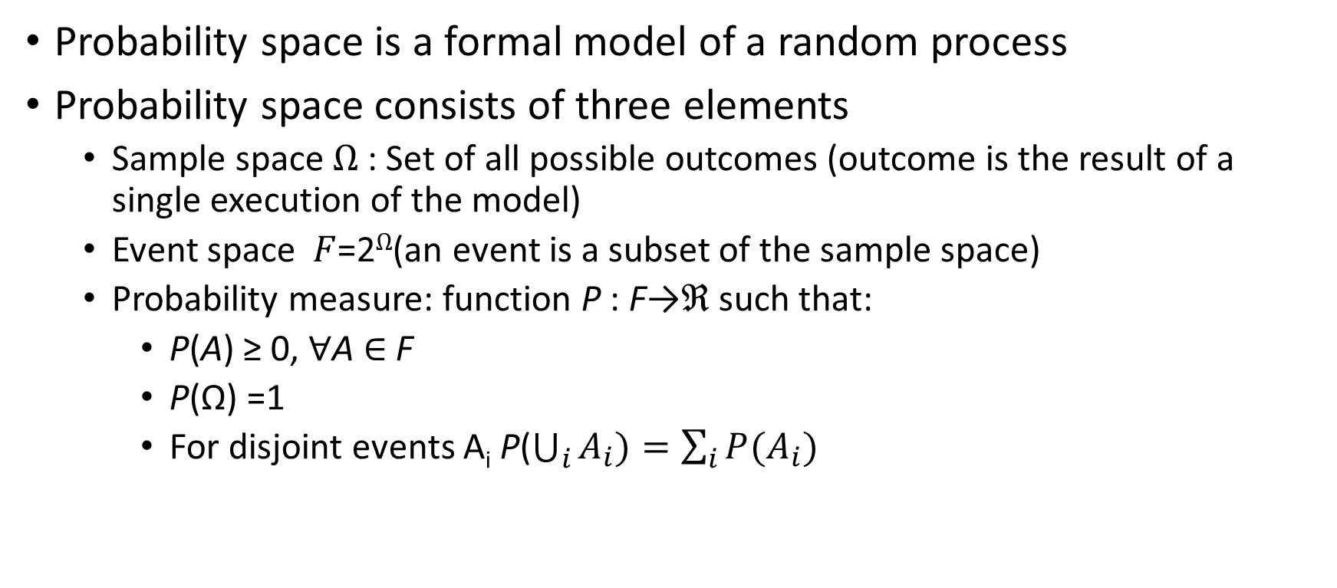
Fundamentals of probabilities
Probability space is a formal model of a random process
Probability space consists of three elements
Sample space Ω : Set of all possible outcomes (outcome is the result of a single execution of the model)
Event space $F$=2^{Ω}(an event is a subset of the sample space)
Probability measure: function P : F→ℜ such that:
P(A) ≥ 0, ∀A ∈ F
P(Ω) =1
For disjoint events A_{i} P($\bigcup_{i}{A_{i}})=\sum_{i}{P(A_{i})}$

Slide 3

Example
Consider throwing a dice twice:
Let A be the event that the sum is even and let B be the event that we roll at least one 6
P(A), P(B), P(A$∪$B), P(A|B)

Slide 4
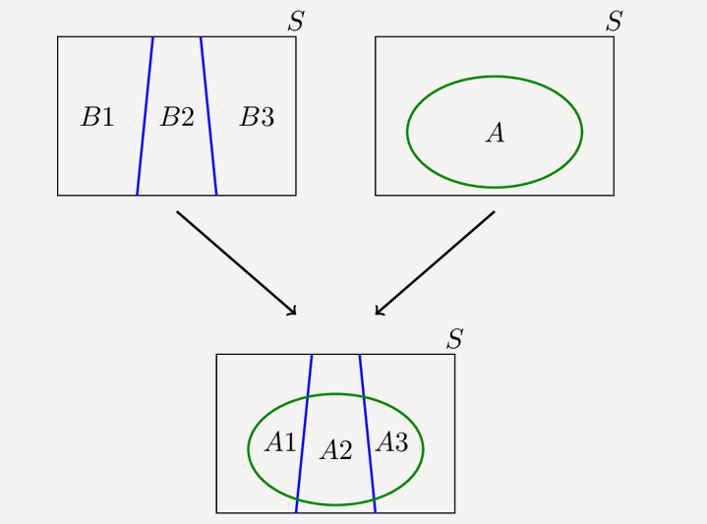
Law of total probability
𝑃(A) = P(𝐴∩𝐵) + P(𝐴∩𝐵^{C})
= P(A|B) P(B) + P(A|𝐵^{C} )P(𝐵^{C} )
[ using the definition of conditional probability]

Slide 5
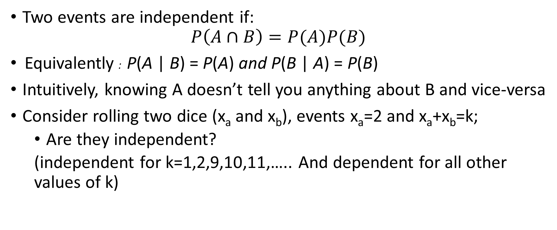
Independence
Two events are independent if:
$$P\left(A∩B\right)=P(A)P(B)$$
Equivalently : P(A | B) = P(A) and P(B | A) = P(B)
Intuitively, knowing A doesn’t tell you anything about B and vice-versa
Consider rolling two dice (x_{a} and x_{b}), events x_{a}=2 and x_{a}+x_{b}=k;
Are they independent?
(independent for k=1,2,9,10,11,….. And dependent for all other values of k)

Slide 6
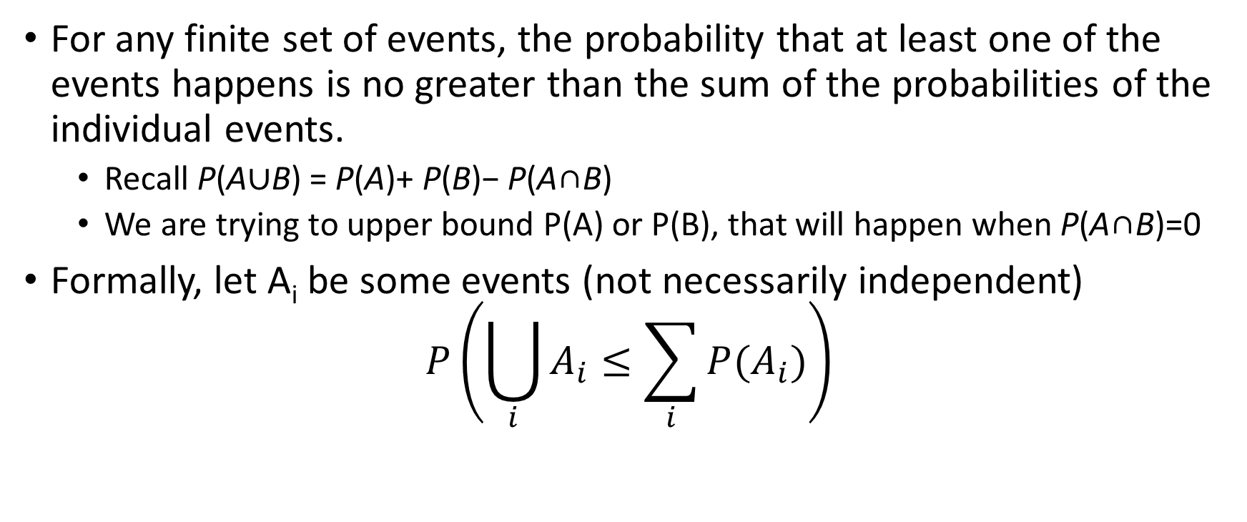
Boole’s Inequality/Union Bound
For any finite set of events, the probability that at least one of the events happens is no greater than the sum of the probabilities of the individual events.
Recall P(A∪B) = P(A)+ P(B)− P(A∩B)
We are trying to upper bound P(A) or P(B), that will happen when P(A∩B)=0
Formally, let A_{i} be some events (not necessarily independent)
$$P\left(\bigcup_{i}{A_{i}≤\sum_{i}{P(A_{i})}}\right)$$

Slide 7
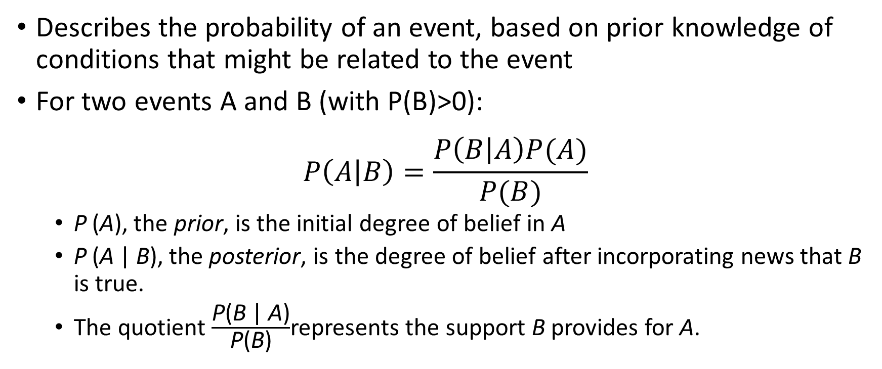
Bayes Rule
Describes the probability of an event, based on prior knowledge of conditions that might be related to the event
For two events A and B (with P(B)>0):
$$P\left(A | B\right)=\frac{P\left(B | A\right)P(A)}{P(B)}$$
P (A), the prior, is the initial degree of belief in A
P (A | B), the posterior, is the degree of belief after incorporating news that B is true.
The quotient $\frac{\text{P}\text{(}\text{B}\text{ | }\text{A}\text{)}}{\text{P}\text{(}\text{B}\text{)}}$represents the support B provides for A.

Slide 8
Example
If a person has malaria, there is a 90% chance that his/her test results are positive.
However, the test result is not very correct; there is a chance for 1% false positive.
Also only 1% of the total population gets affected by Malaria.
Now one person's test result came out as Positive. What’s the odds that he will actually have Malaria?

Slide 9
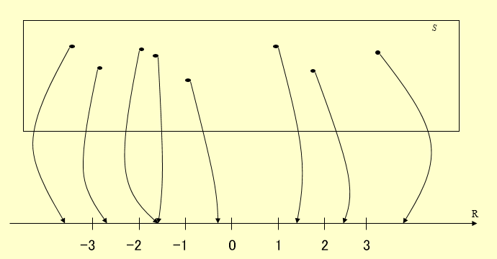
Random Variables
A random variable is a real-valued function defined on the sample space
X :Ω→ℜ
Two types
Discrete r.v.
Continuous r.v.
Why is it called random?

Slide 10
Probability Mass Function
Probability Mass Function (p.m.f.)
A set of probability values p assigned to each of the values taken by the discrete random variable and
P(X = k) = P({ω ∈ Ω| X(ω) = k)
Let X be a random variable (r.v.) that counts the number of 6’s we roll in a 2 dice rolls
P(X=2)=P({6,6}) = 1/36
P(X=1)=P({1,6})+P({2,6})+P({3,6})+…+P({5,6})+P({6,1})+…=10/36
P(X=0)=? = 25/36

Slide 11
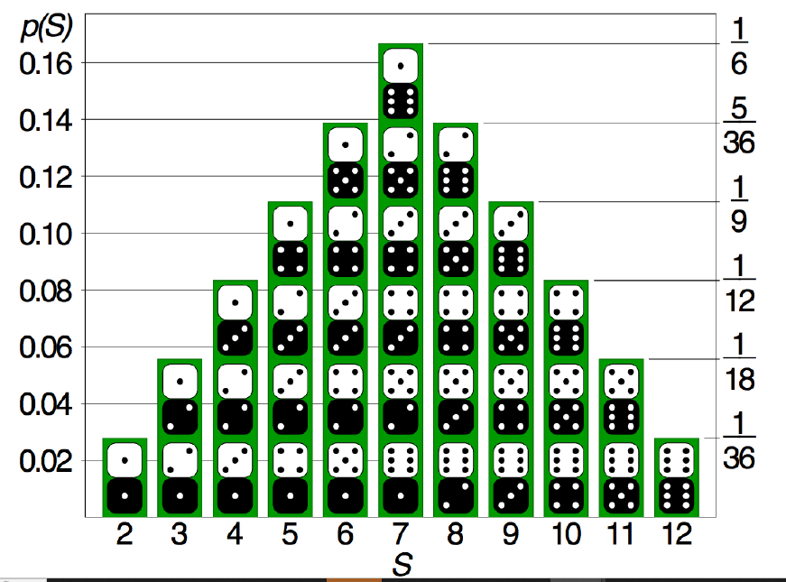
Distribution
Recording all the probabilities of outputs of a random variable X yields the probability distribution of X.
Ex: Distribution of sum (S) of possible numbers rolled on two dice
Courtesy: Wikipedia

Slide 12
Continuous random variables
A continuous random variable is a random variable whose cumulative distribution function is continuous everywhere
Probability Density Function (p.d.f.): function that gives the probability that the value of the random variable will fall between a range of values.
f(x) = dF(x)dx = F'(x)
(F(x) is the cdf)
(pdf cannot be negative)
(total area under the curve must be 1)

Slide 13
Cumulative Distribution Function (cdf)
Cumulative distribution function of a random variable X, or just the distribution function of X, is the probability that X will take a value less than or equal to x
(for discrete r.v.)
(for continuous r.v.)

Slide 14


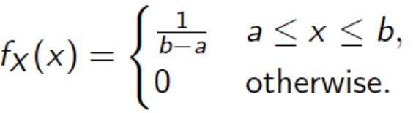
Common random variables
Bernoulli r.v.: Probability distribution of a random variable that takes value 1 with probability p and 0 with probability q = 1 − p
Geometric r.v.: The first success requires k independent trials
Uniform r.v: Outcome lies between bounds a and b

Slide 15


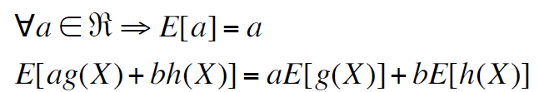
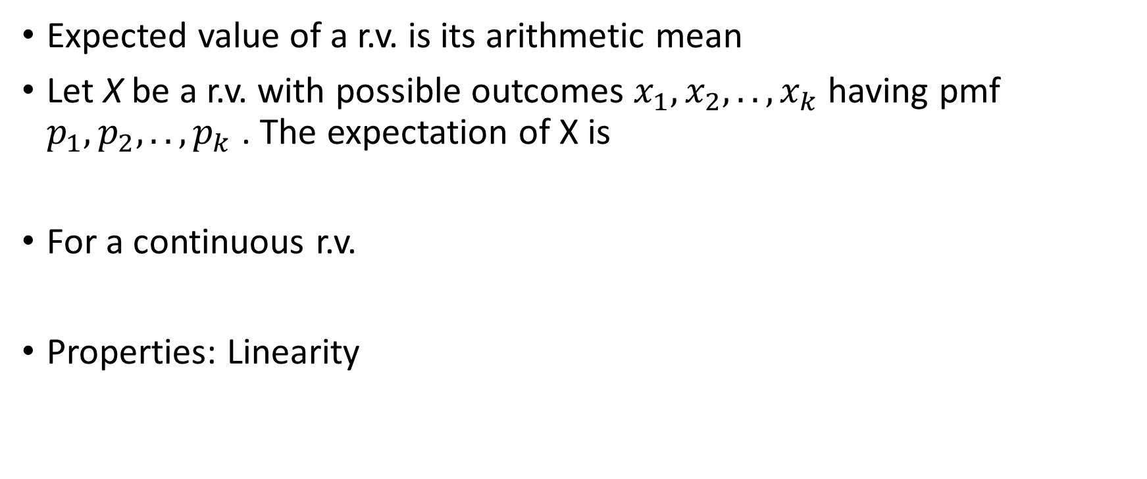
Expectation
Expected value of a r.v. is its arithmetic mean
Let X be a r.v. with possible outcomes $x_{1},x_{2}, .., x_{k}$having pmf $p_{1},p_{2}, .., p_{k}$ . The expectation of X is
For a continuous r.v.
Properties: Linearity

Slide 16
Variance
Variance is the expectation of the squared deviation of a random variable from its population mean or sample mean.
the variance of X is equal to the mean of the square of X minus the square of the mean of X

Slide 17
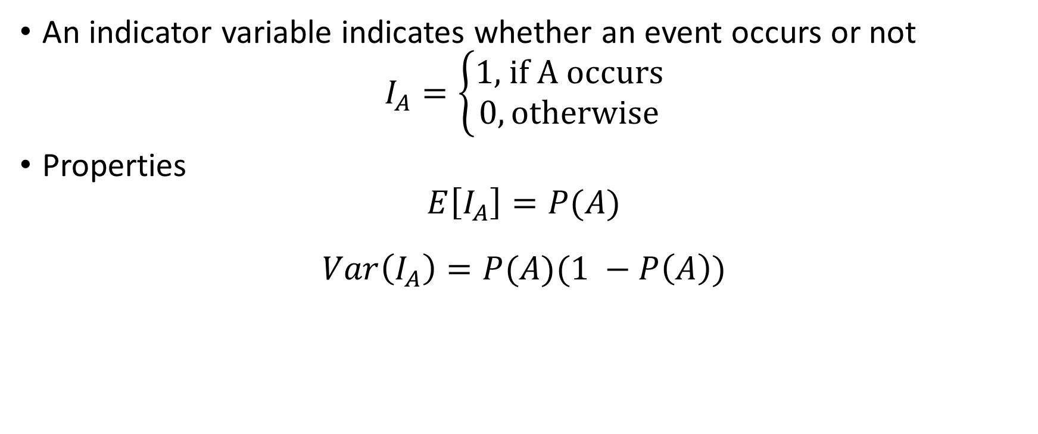
Indicator variables
An indicator variable indicates whether an event occurs or not
$$I_{A}=\left\{\begin{aligned}1\text{, }\text{if} \text{A} \text{occurs} \\ 0, \text{otherwise}\end{aligned}\right.$$
Properties
$$E\left[I_{A}\right]=P(A)$$
$$Var\left(I_{A}\right)=P(A)(1 −P\left(A\right))$$

Slide 18
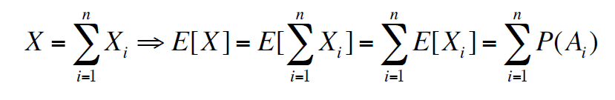

Indicator variable: usage
Useful when we need to find E[X] for a counting variable X
Let X is the count of events that occur among a collection of events $A_{1}, ..,A_{n}$ having indicator r.v. $X_{1}, .., X_{n}$ , then

Slide 19
Example
N professors are at a dinner and take a random coat when they leave. What is the expected number of professors with the right coat?

Slide 20
Parametric distribution
Family of probability distributions that is characterized by a finite number of parameters
The pdf or pmf is defined using a set of parameters that determine the shape, location, and scale of the distribution
Normal Distribution (Gaussian Distribution):
Parameters: Mean (μ) and Standard Deviation (σ). Noted as N(μ,σ²)
Exponential Distribution:
Parameter: Rate (λ).
Binomial Distribution:
Parameters: Number of trials (n) and Probability of success in each trial (p).
Models the number of successes in a fixed number of independent Bernoulli trials.

Slide 21

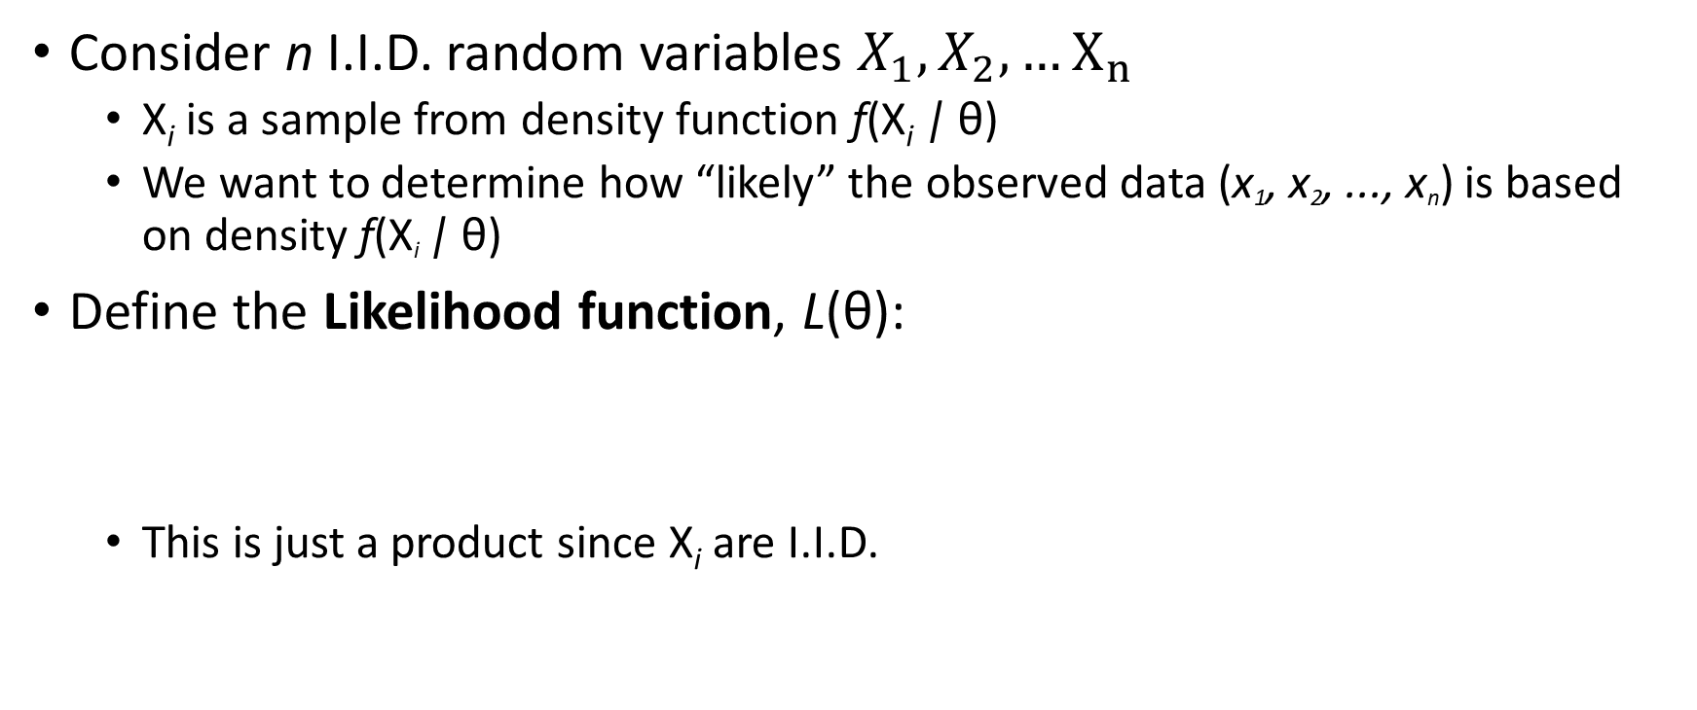
Likelihood of Data
Consider n I.I.D. random variables $X_{1}, X_{2}, …X_{n}$
X_{i} is a sample from density function f(X_{i} | θ)
We want to determine how “likely” the observed data (x₁, x₂, ..., x_{n}) is based on density f(X_{i} | θ)
Define the Likelihood function, L(θ):
This is just a product since X_{i} are I.I.D.

Slide 22


Maximum Likelihood Estimator
The Maximum Likelihood Estimator (MLE) of θ, is the value of θ that maximizes L(θ)
$$θ_{MLE}= {argmax \atop θ}L(θ)$$
More convenient to use log-­likelihood function, LL(θ):

Slide 23
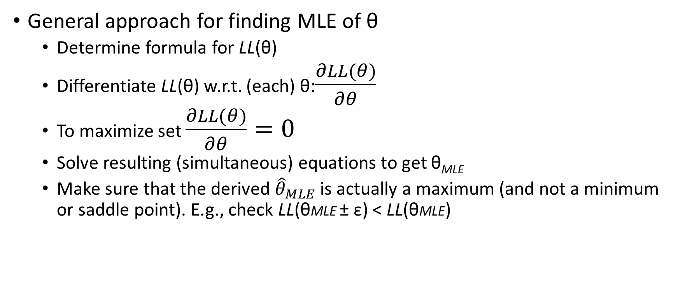
Computing the MLE
General approach for finding MLE of θ
Determine formula for LL(θ)
Differentiate LL(θ) w.r.t. (each) θ:$\frac{∂LL(θ)}{∂θ}$
To maximize set $\frac{∂LL(θ)}{∂θ}=0$
Solve resulting (simultaneous) equations to get θ_{MLE}
Make sure that the derived ${\hat{θ}}_{MLE}$ is actually a maximum (and not a minimum or saddle point). E.g., check LL(θMLE ± ε) < LL(θMLE)

Slide 24
Parameter estimation: Maximum likelihood
Assume we have a parametrized distribution fX(x;θ) and we
do not know parameter θ (could be a vector as well)
We observe IID samples x1,x2,…,xn
Goal: Estimate θ
The maximum likelihood estimator (MLE) is the value that maximizes the likelihood of observing the data/samples you observed

Slide 25


Some useful inequalities
Chebyshev’s Inequality
If a random variable has a mean and a variance , then
guarantees only a definite fraction of values will be found within a specific distance from the mean of a distribution.
Ex. c =2,

Slide 26
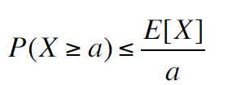
Some useful inequalities
Markov’s inequality
Let X is a nonnegative random variable and a > 0, then the probability that X is at least a is at most the expectation of X divided by a
Continuing with our previous example, the probability of at least 5 professors get the right coats is no higher than 20%

Slide 27
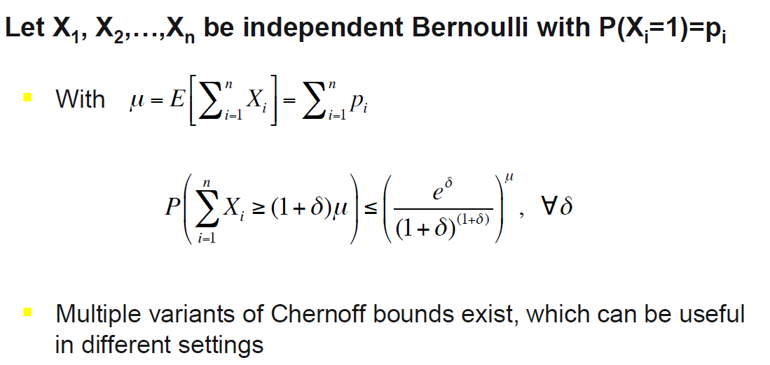
Chernoff bound

Slide 28
Thank you

